Slide 1
Final Game Presentation
Bailey Page

Slide 2
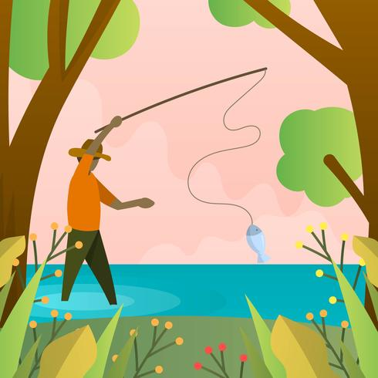
Introduction
Hello, I’m Ben!
My game is called Catch!

Slide 3
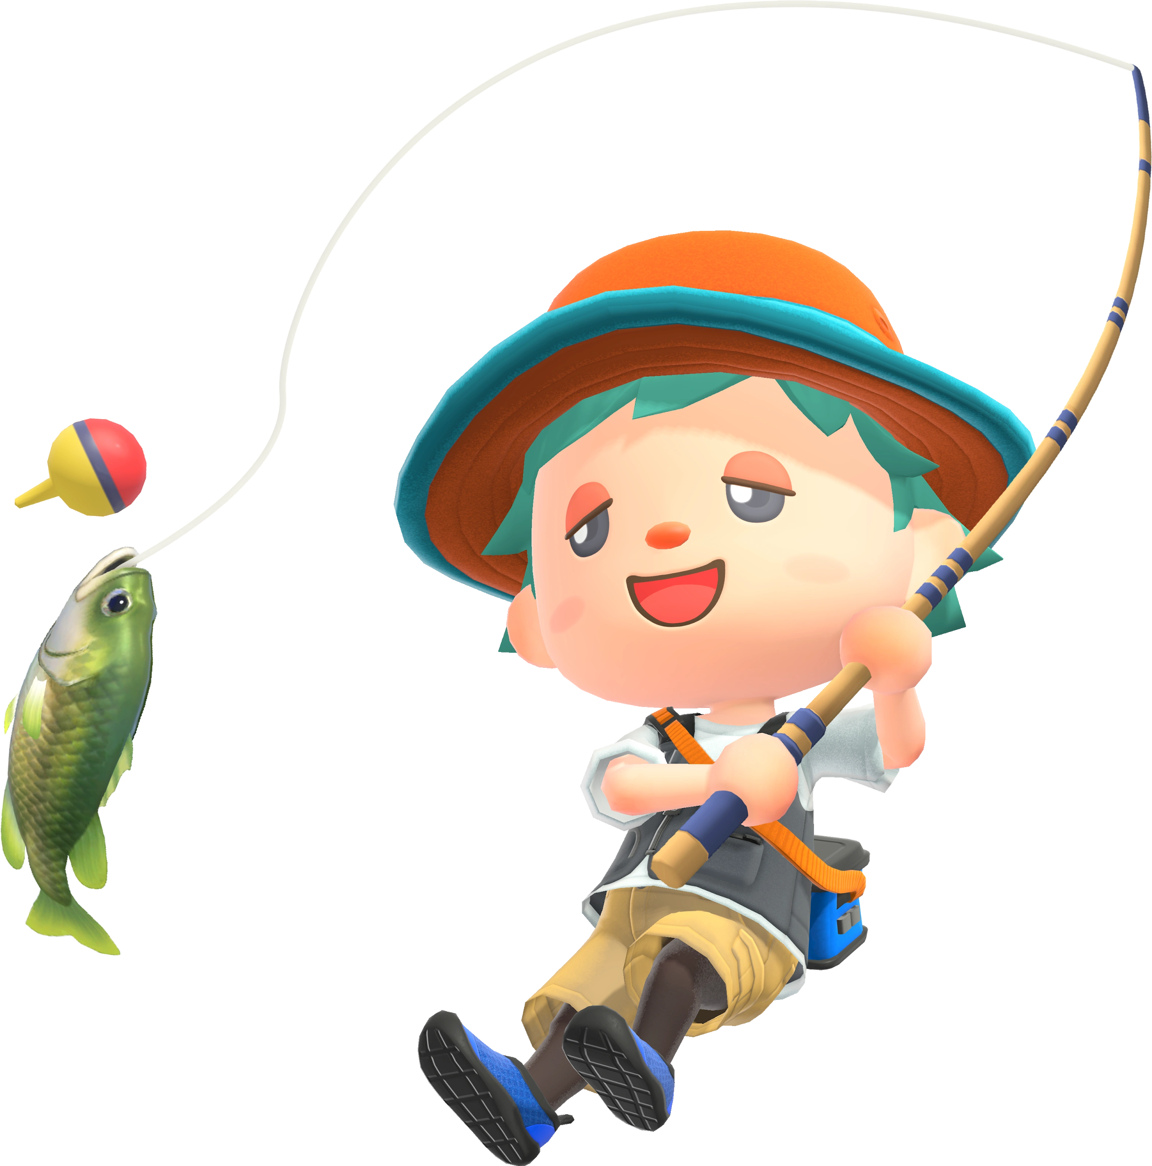
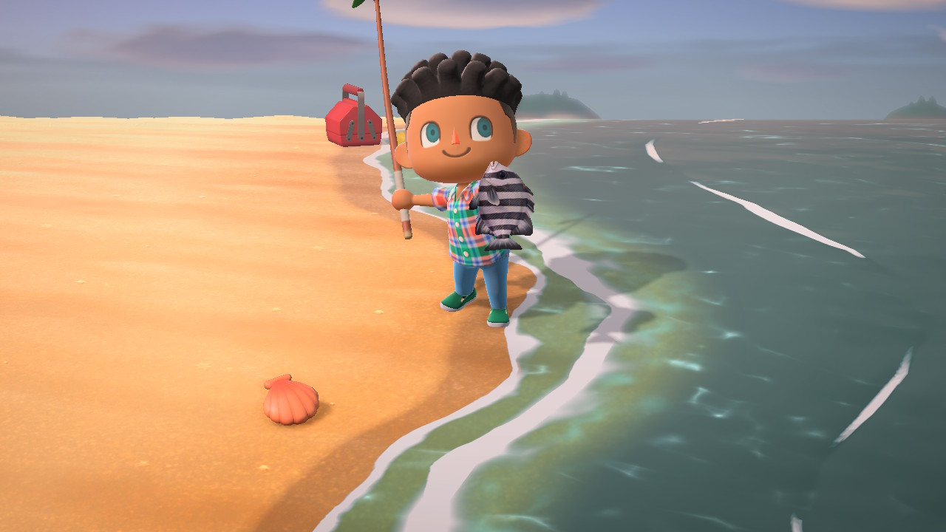
Brainstorming
In a late night conversation with my marine-ecologist girlfriend, she proposed the idea of a VR game in the style of Animal Crossing.
What started as a 40 animal catching simulator turned into a 10 fish catching game for time and Unity complications.

Slide 4

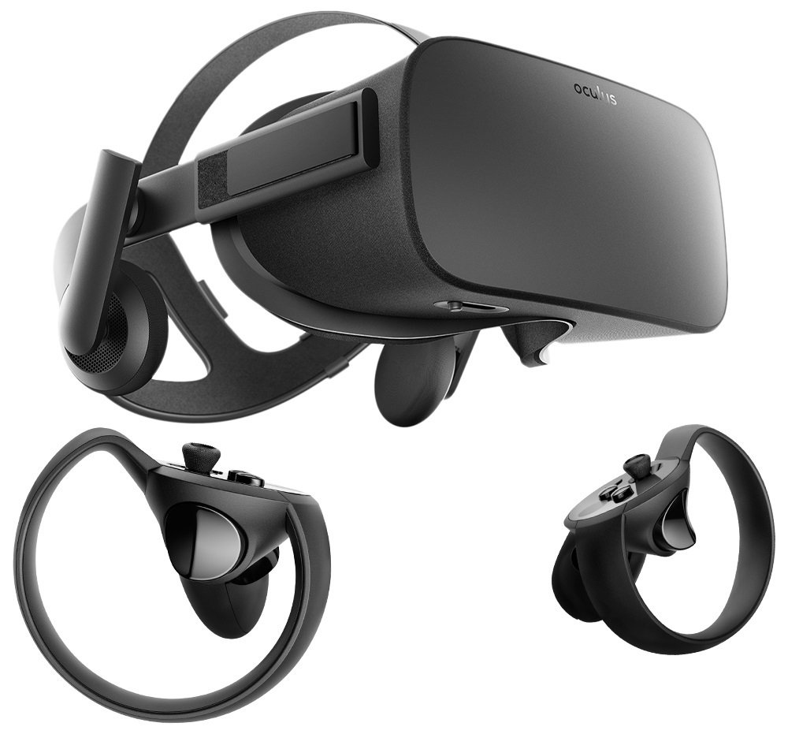
Technology Use
This is a VR Title
I used my laptop and my first gen Oculus Rift.
This can be played on any Oculus headset but has no support for HTC Vive or Valve Index.
I used the 2019 release of Unity, 2020’s Oculus support is in a quite unusable state.

Slide 5
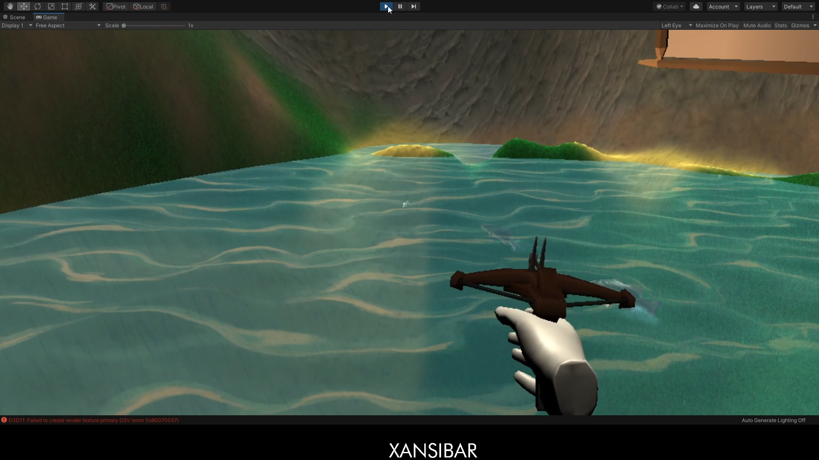
Mechanics
You use your right hand as you fire your crossbow at the fish.
Collect all 10 Fish while learning about the ones you catch.
You can walk and sprint, but the best spot is the deck.

Slide 6
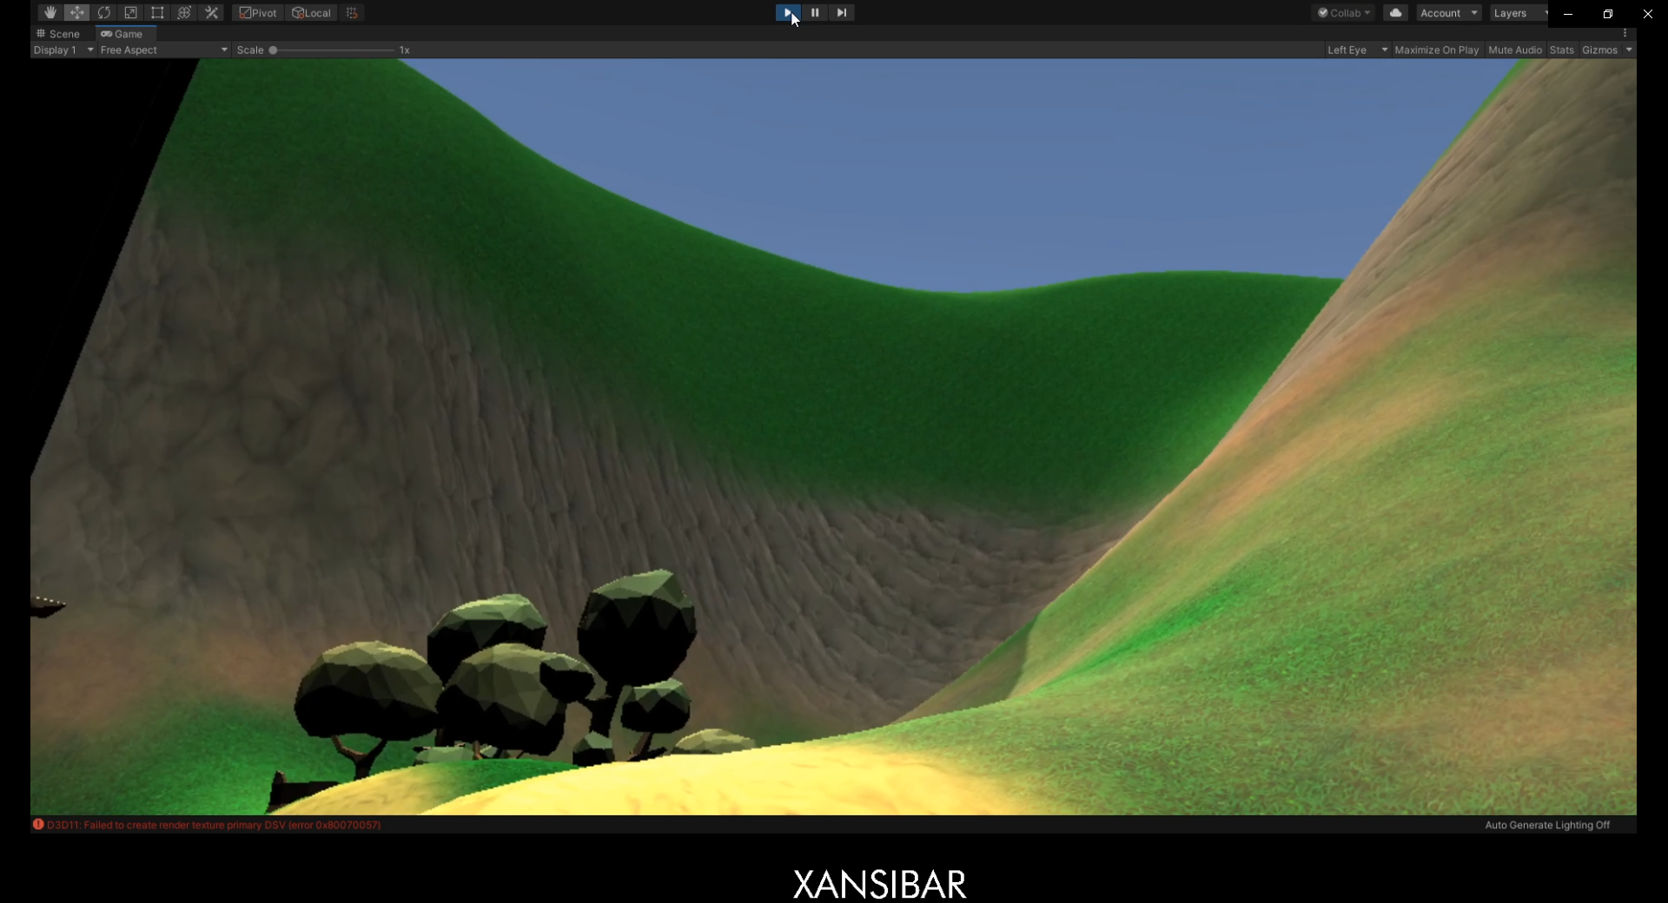
Environment and Interaction
You are in a small enclosed space with a lake.
It is a pretty island with minimalist design.
There is dynamic lighting with real time shadows.
Fish swim (mostly) natural.

Slide 7
Testing Process
The fish began as circles that swung back and forth.
People did not like this.
Dr. Ebrahimi provided me a fish Unity package that was a great use.
I replaced the circles with fish that swung back and forth.
People did not like this either.
I used scripts within the package to make fish move freely within the lake.
People did like this!
However, due to the package scripts being old, sometimes the fish had a tendency to fly.
I liked this, but bugs are not good game design.

Slide 8
Comments
I had some classmates and my brother test my game over the months and their main points through the year were:
“Circles are not natural”
“The fish need to move more fluidly.”
And my personal favorite; “Why did the dolphin fly?”

Slide 9
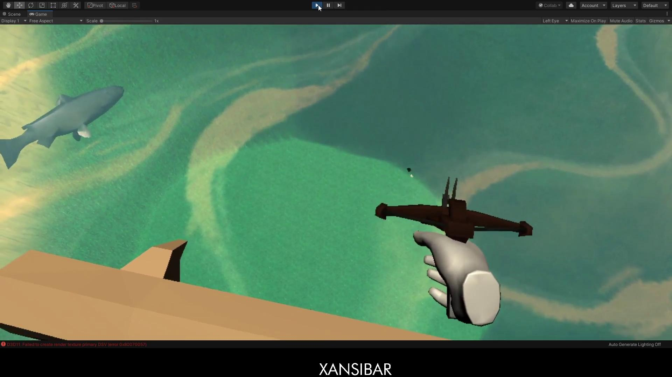
Demo
Link to game.

Slide 10
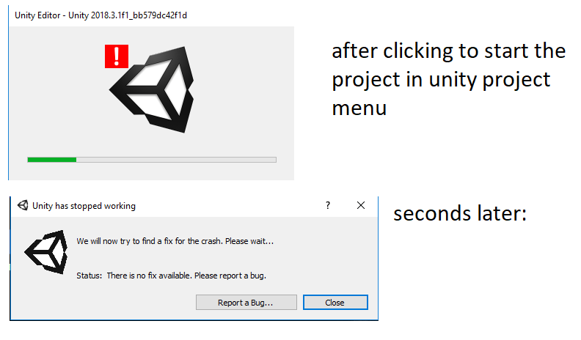
Highs and Lows
During the first two months, I had fishing rod physics working but my game decided to kick the bucket corrupting all work and rendering it useless.
Hand scripting VR interaction and collision was the most difficult programming challenge of my life, but the moment it all clicked, I remembered why this is what I wanted to do for a career.
Watching a dolphin take to the sky was one of the funniest glitches I have ever seen in a video game.

Slide 11
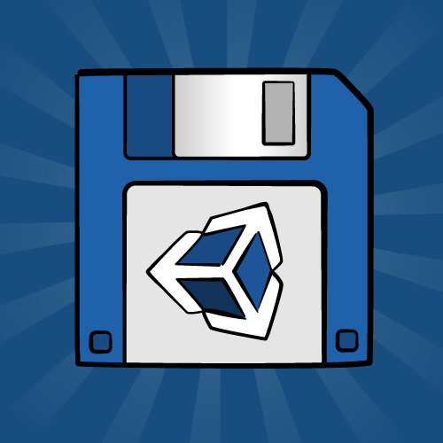
Recommendations
Save often.
After Milestones, save multiple copies of the game in case of corruption.
Listen to feedback.
Your vision is not always perfect.
Be willing to make compromises for the sake of sanity and good game design.

Slide 12
Questions?

